Slide 1
9
Application: International Trade

Slide 2

Figure 1The Equilibrium without International Trade
Price
of Steel
Domestic
supply
Consumer
surplus
Equilibrium
price
Producer
surplus
Domestic
demand
0
Equilibrium
Quantity
quantity
of Steel
Copyright © 2004 South-Western

Slide 3
Figure 2 International Trade in an Exporting Country
Price
of Steel
Price
Domestic
after
supply
trade
World
price
Price
before
trade
Domestic
Exports
demand
0
Domestic
Domestic
Quantity
quantity
quantity
of Steel
demanded
supplied
Copyright © 2004 South-Western

Slide 4
Figure 3 How Free Trade Affects Welfare in an Exporting Country
Price
of Steel
Domestic
Price
supply
after
A
Exports
trade
World
B
D
price
Price
before
C
trade
Domestic
demand
0
Quantity
of Steel
Copyright © 2004 South-Western

Slide 5
Figure 3 How Free Trade Affects Welfare in an Exporting Country
Price
of Steel
Consumer surplus
before trade
Domestic
Price
supply
after
A
Exports
trade
World
B
D
price
Price
before
C
trade
Producer surplus
before trade
Domestic
demand
0
Quantity
of Steel
Copyright © 2004 South-Western

Slide 6
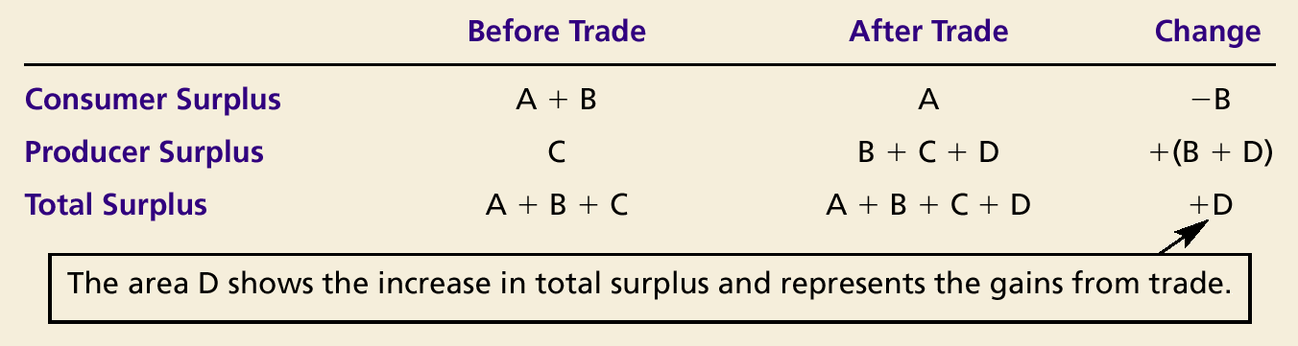
How Free Trade Affects Welfare in an Exporting Country

Slide 7
Figure 4 International Trade in an Importing Country
Price
of Steel
Domestic
supply
Price
before
trade
Price
World
after
price
trade
Domestic
Imports
demand
0
Domestic
Domestic
Quantity
quantity
quantity
of Steel
supplied
demanded
Copyright © 2004 South-Western

Slide 8
Figure 5 How Free Trade Affects Welfare in an Importing Country
Price
of Steel
Domestic
supply
A
Price
before trade
B
D
Price
World
after trade
C
price
Imports
Domestic
demand
0
Quantity
of Steel
Copyright © 2004 South-Western

Slide 9
Figure 5 How Free Trade Affects Welfare in an Importing Country
Price
of Steel
Consumer surplus
before trade
Domestic
supply
A
Price
before trade
B
Price
World
after trade
C
price
Producer surplus
before trade
Domestic
demand
0
Quantity
of Steel
Copyright © 2004 South-Western

Slide 10
Figure 5 How Free Trade Affects Welfare in an Importing Country
Price
of Steel
Consumer surplus
after trade
Domestic
supply
A
Price
before trade
B
D
Price
World
after trade
C
price
Imports
Producer surplus
after trade
Domestic
demand
0
Quantity
of Steel
Copyright © 2004 South-Western

Slide 11
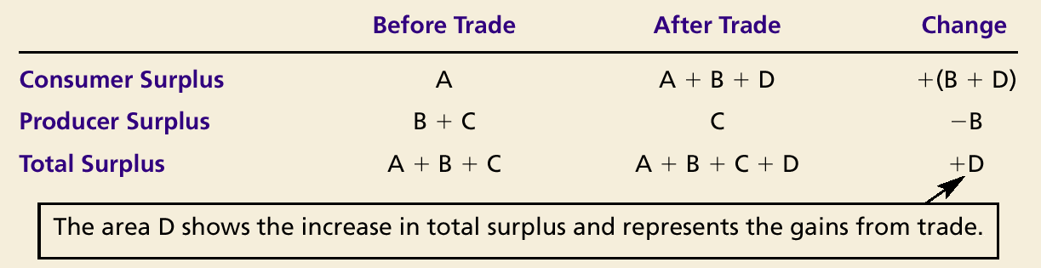
How Free Trade Affects Welfare in an Importing Country

Slide 12
Figure 6 The Effects of a Tariff
Price
of Steel
Domestic
supply
Equilibrium
without trade
Price
with tariff
Tariff
Price
World
without tariff
Imports
price
with tariff
Domestic
demand
0
Q
S
Q
S
Q
D
Q
D
Quantity
of Steel
Imports
without tariff
Copyright © 2004 South-Western

Slide 13
Figure 6 The Effects of a Tariff
Price
of Steel
Consumer surplus
before tariff
Domestic
supply
Producer surplus
before tariff
Equilibrium
without trade
Price
World
without tariff
price
Domestic
demand
0
Q
S
Q
D
Quantity
of Steel
Imports
without tariff
Copyright © 2004 South-Western

Slide 14
Figure 6 The Effects of a Tariff
Price
of Steel
Consumer surplus
with tariff
Domestic
supply
A
Equilibrium
without trade
B
Price
with tariff
Tariff
Price
World
without tariff
Imports
price
with tariff
Domestic
demand
0
Q
S
Q
S
Q
D
Q
D
Quantity
of Steel
Imports
without tariff
Copyright © 2004 South-Western

Slide 15
Figure 6 The Effects of a Tariff
Price
of Steel
Domestic
supply
Producer surplus
after tariff
Equilibrium
without trade
Price
with tariff
C
Tariff
Price
World
without tariff
G
Imports
price
with tariff
Domestic
demand
0
Q
S
Q
S
Q
D
Q
D
Quantity
of Steel
Imports
without tariff
Copyright © 2004 South-Western

Slide 16
Figure 6 The Effects of a Tariff
Price
of Steel
Domestic
supply
Tariff Revenue
Price
with tariff
Tariff
Price
E
World
without tariff
Imports
price
with tariff
Domestic
demand
0
Q
S
Q
S
Q
D
Q
D
Quantity
of Steel
Imports
without tariff
Copyright © 2004 South-Western

Slide 17
Figure 6 The Effects of a Tariff
Price
of Steel
Domestic
supply
A
Deadweight Loss
B
Price
with tariff
C
Tariff
Price
D
E
F
World
without tariff
G
Imports
price
with tariff
Domestic
demand
0
Q
S
Q
S
Q
D
Q
D
Quantity
of Steel
Imports
without tariff
Copyright © 2004 South-Western

Slide 18
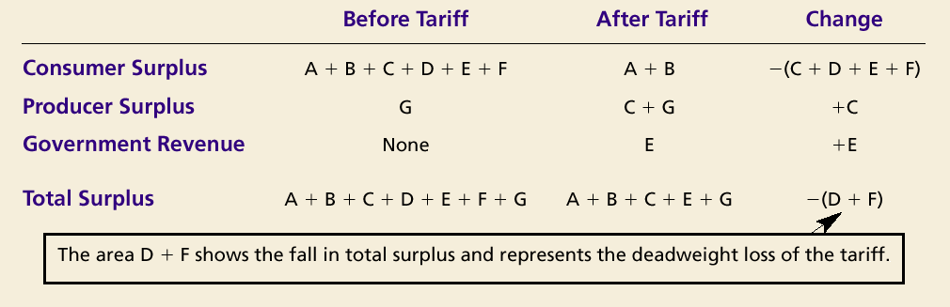
The Effects of a Tariff

Slide 19
Figure 7 The Effects of an Import Quota
Price
of Steel
Domestic
supply
Equilibrium
without trade
Quota
Domestic
supply
+
Isolandian
Import supply
price with
Equilibrium
quota
with quota
Price
World
World
without
=
price
price
quota
Imports
Domestic
with quota
demand
0
Q
S
Q
S
Q
D
Q
D
Quantity
of Steel
Imports
without quota
Copyright © 2004 South-Western

Slide 20
Figure 7 The Effects of an Import Quota
Price
of Steel
Domestic
supply
Equilibrium
without trade
Quota
Domestic
A
supply
+
Isolandian
Import supply
price with
B
quota
Equilibrium
with quota
C
D
E'
F
Price
World
E"
World
without
=
price
G
price
quota
Imports
Domestic
with quota
demand
0
Q
S
Q
S
Q
D
Q
D
Quantity
of Steel
Imports
without quota
Copyright © 2004 South-Western

Slide 21
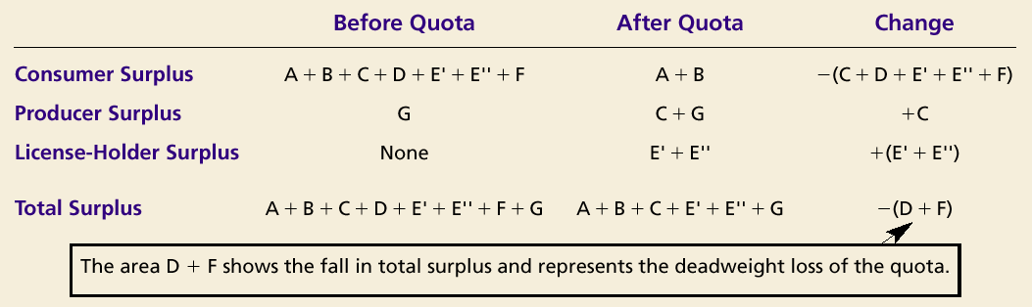
The Effects of an Import Quota

